Slide 1
Climatological mean features and interannual to decadal variability of ring formations in the Kuroshio Extension region
Yoshi N. Sasaki and S. Minobe
Faculty of Science, Hokkaido University, Japan

Slide 2
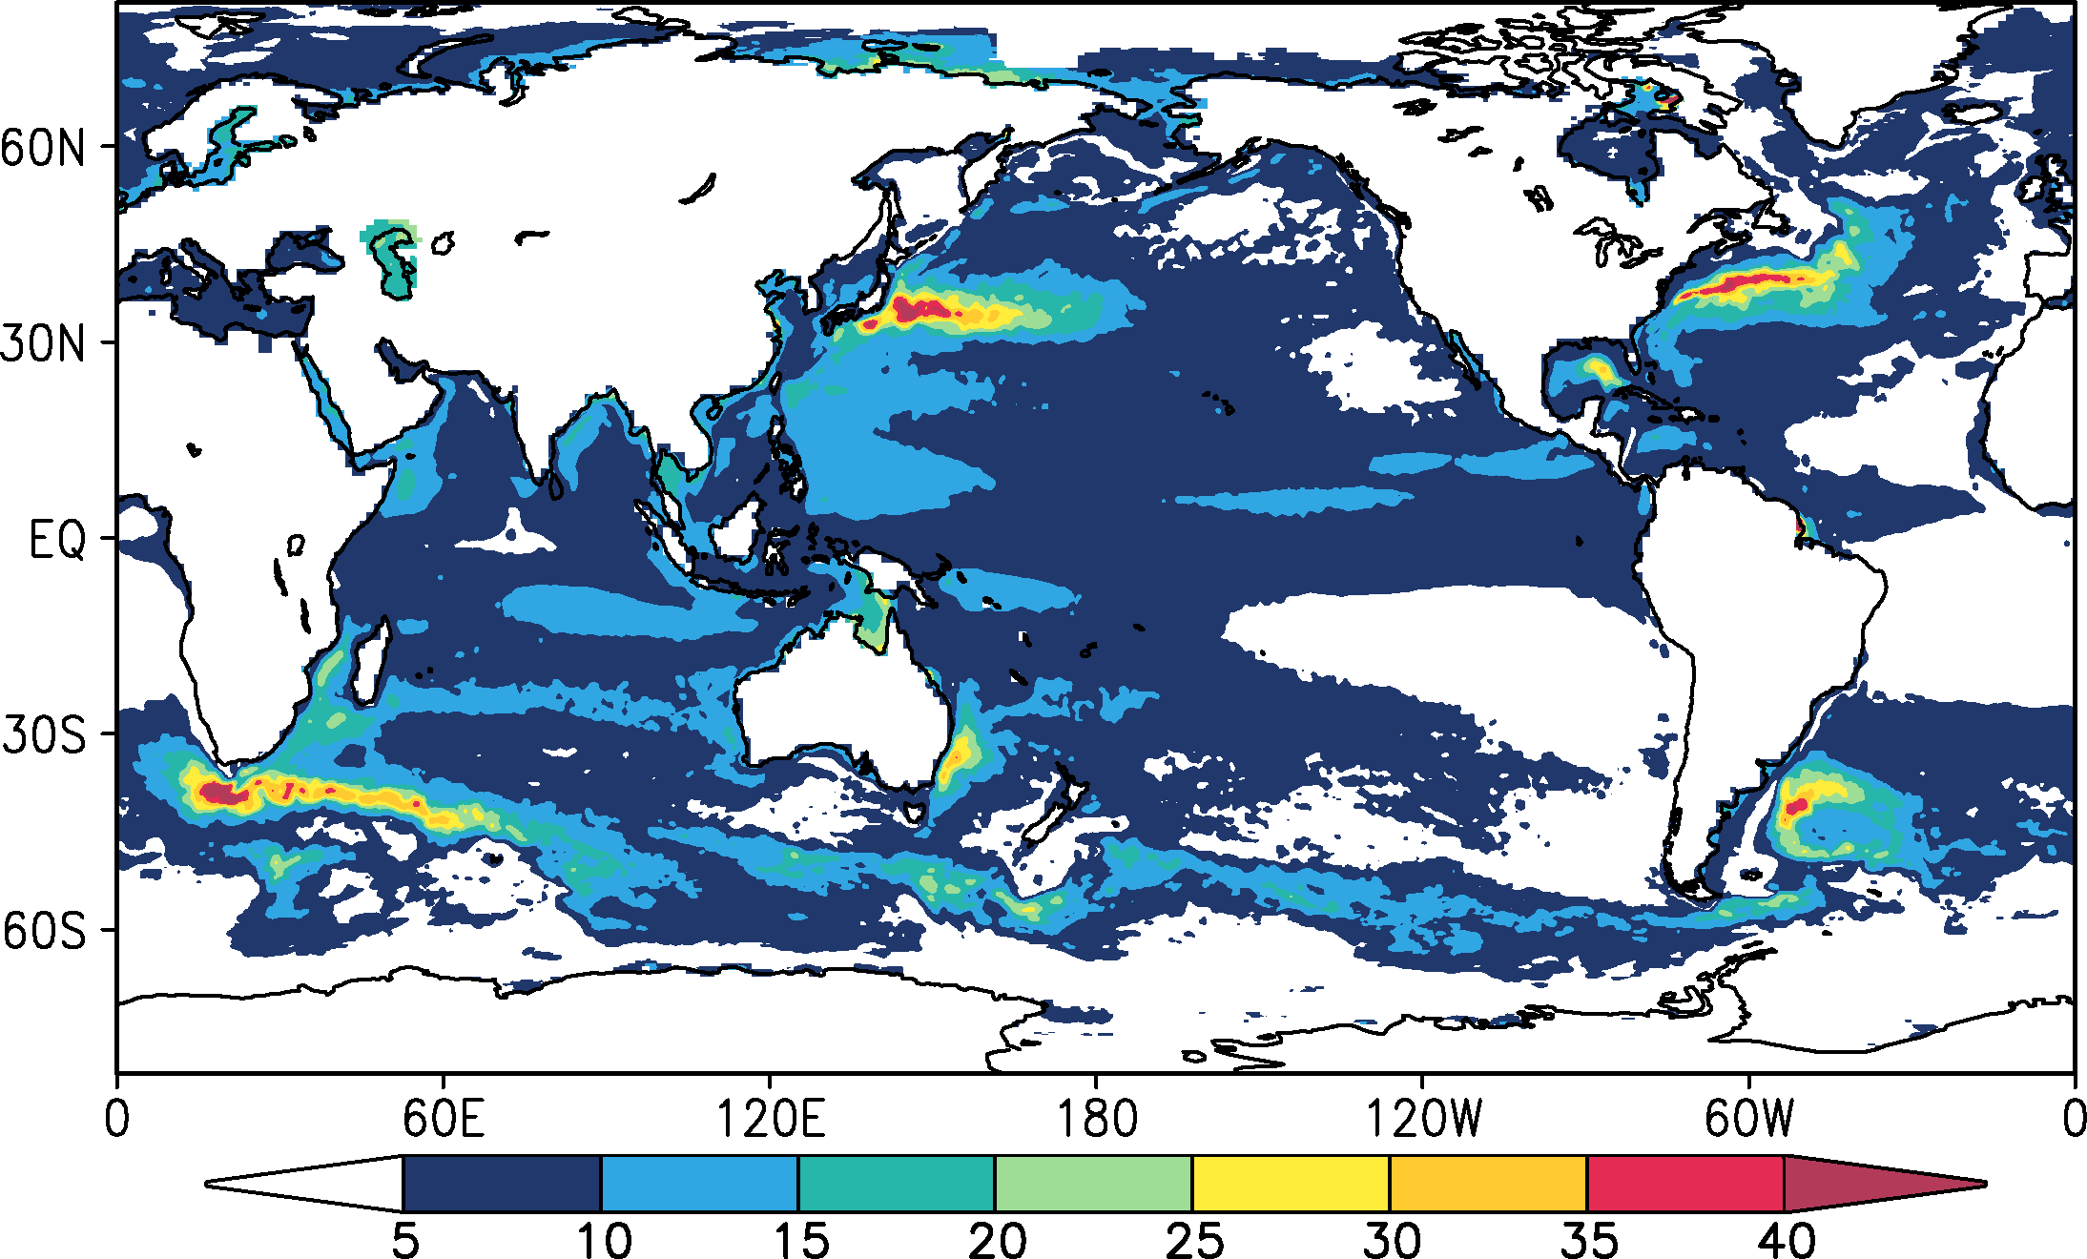
Kuroshio Extension (KE) region
Standard deviation of sea level
Kuroshio Extension
[cm]

Slide 3
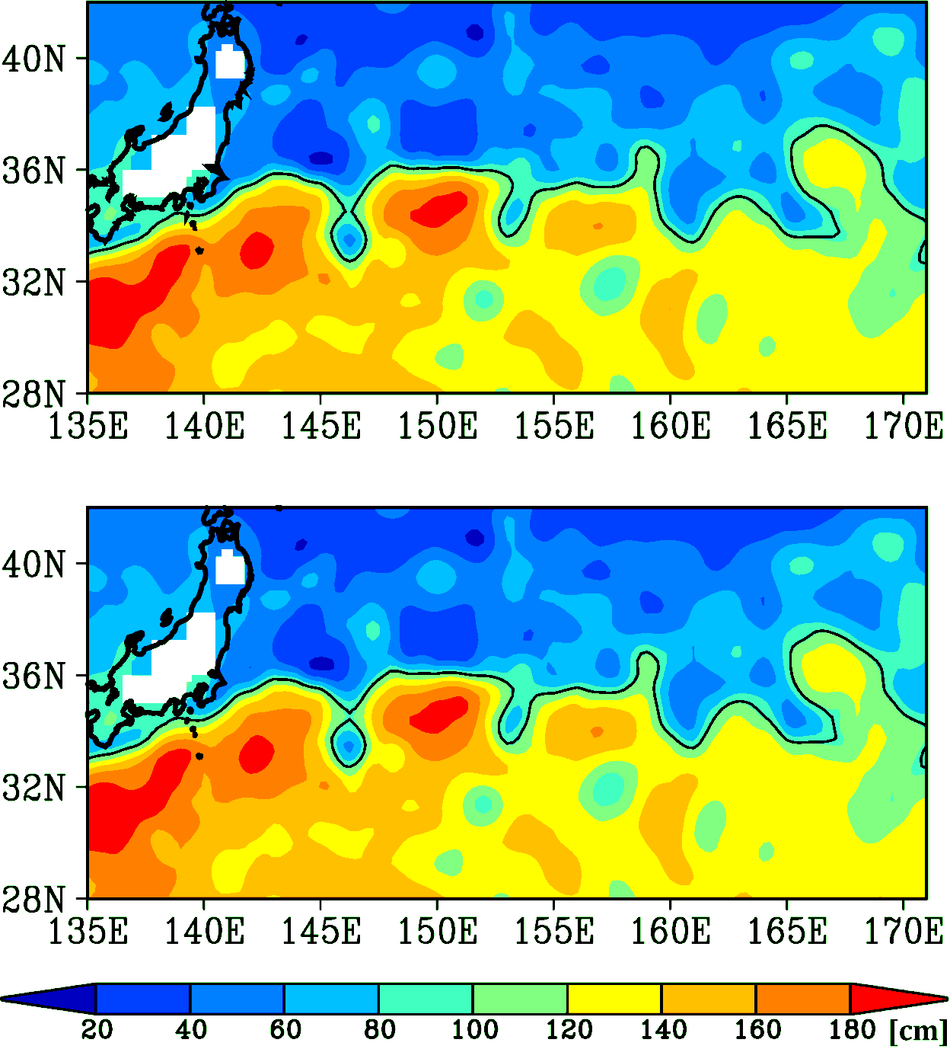
Ring formaiton in the KE region
An eddy shed from a jet is referred as a ring
Rings transport large amount of heat, salt and momentum
11 July 2010
12 July 2010

Slide 4
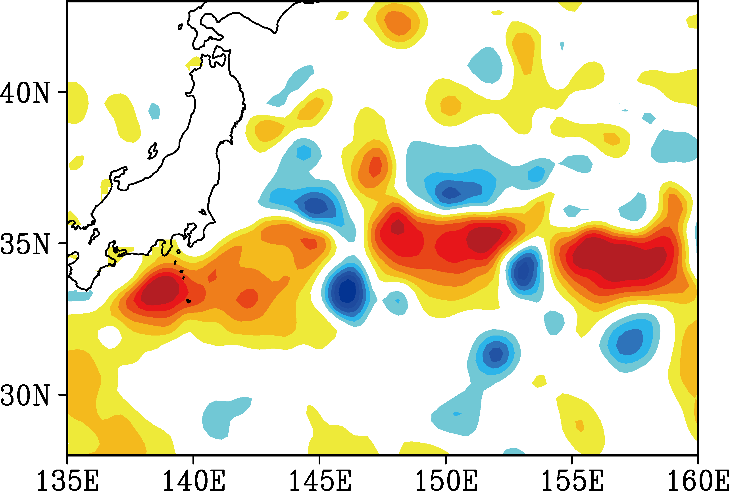
Ring, Eddy or Meander?
Sea Level Anomaly

Slide 5
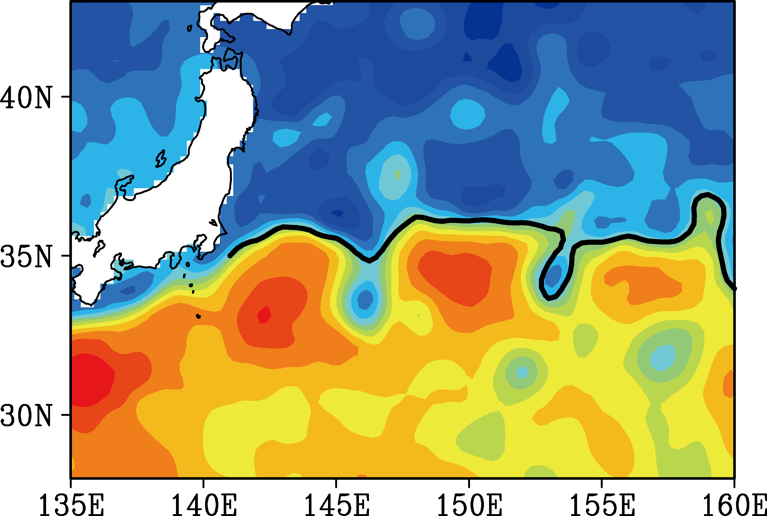
Ring, Eddy or Meander?
Sea Surface Height
Meander
Ring
Eddy

Slide 6
Purposes
To propose a new method for objectively capturing ring formation
To apply this mothed to clarify ring properties in the KE region
across-jet heat transport

Slide 7
Procedure
The path of the KE jet axis is determined from daily sea surface height by AVISO
If the length of the jet decreases by more than 300 km per day, this decrease is a candidate of a ring formation
The pinched-off ring is tracked using a neighbor enclosed area tracking method (Inatsu 2009)
If the ring survives more than 14 days, we consider that the ring formation event has occurred

Slide 8
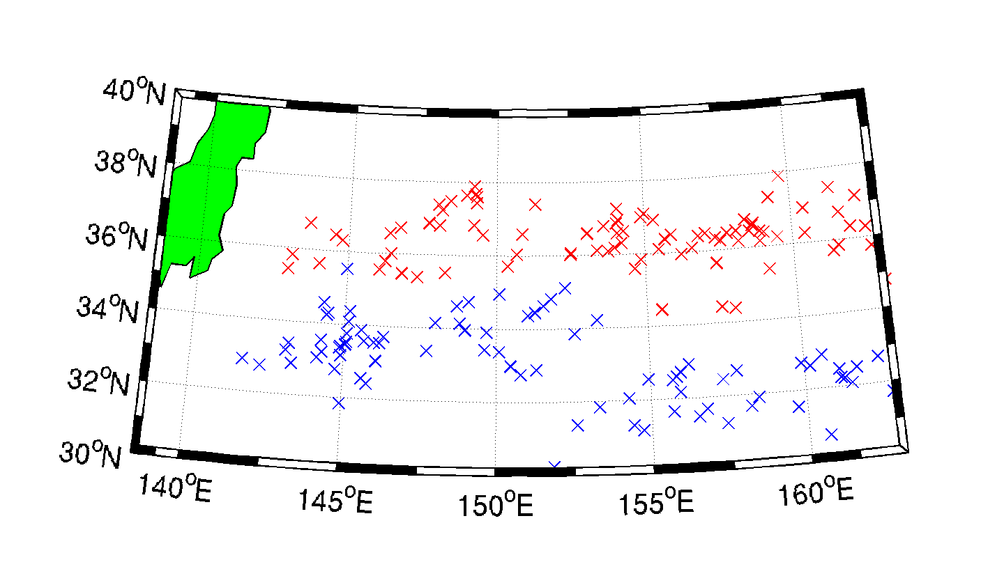
Trajectory

Slide 9
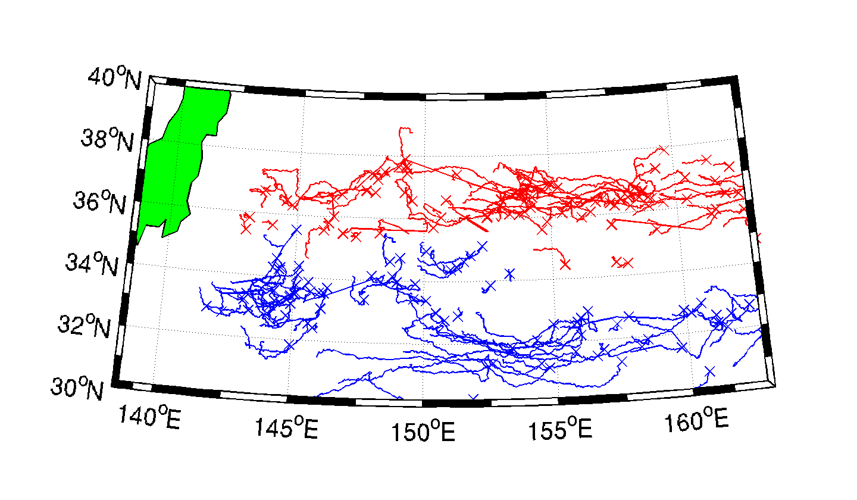
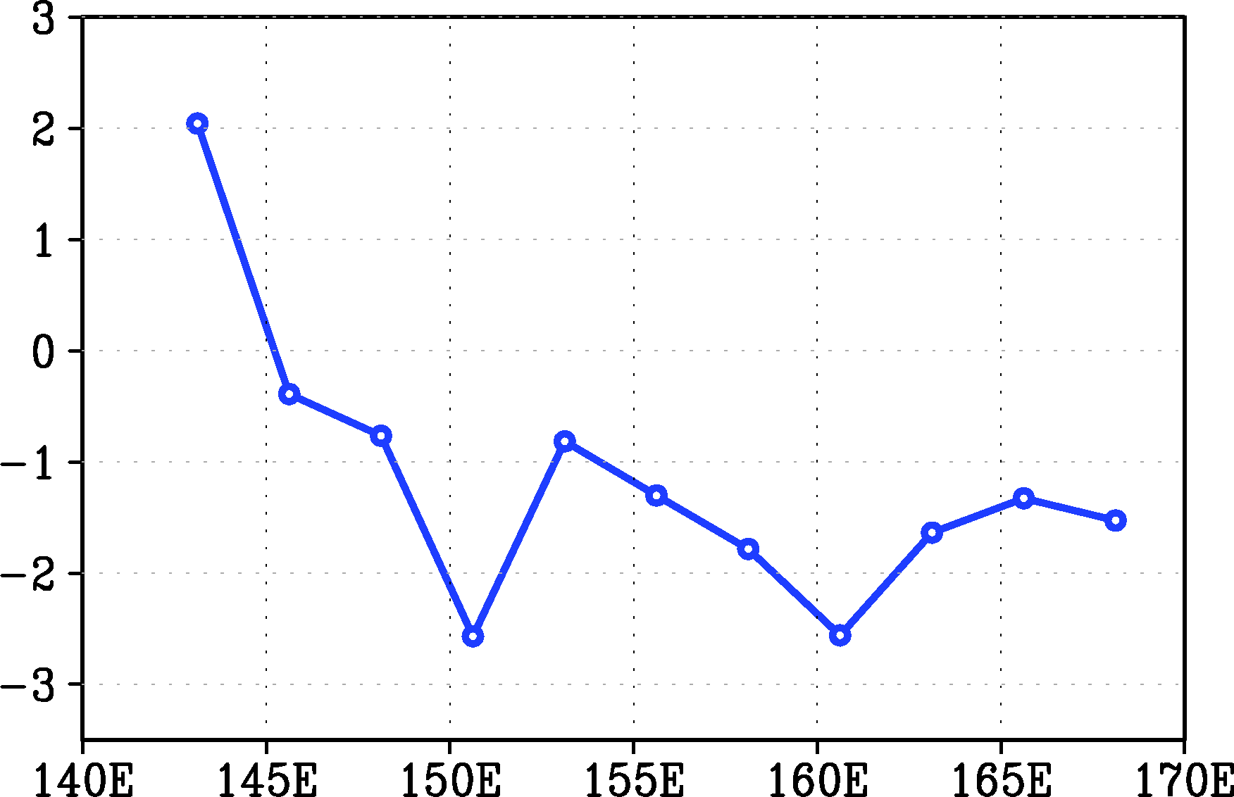
Trajectory
The westward propagation speed of anticyclonic and cyclonic rings was 2.6 cm s⁻¹ and 3.4 cm s⁻¹, respectively.
Zonal phase speed of the KE meander
[cm/s]

Slide 10
Ring properties
amplitude
relative vorticity
lifetime
area

Slide 11
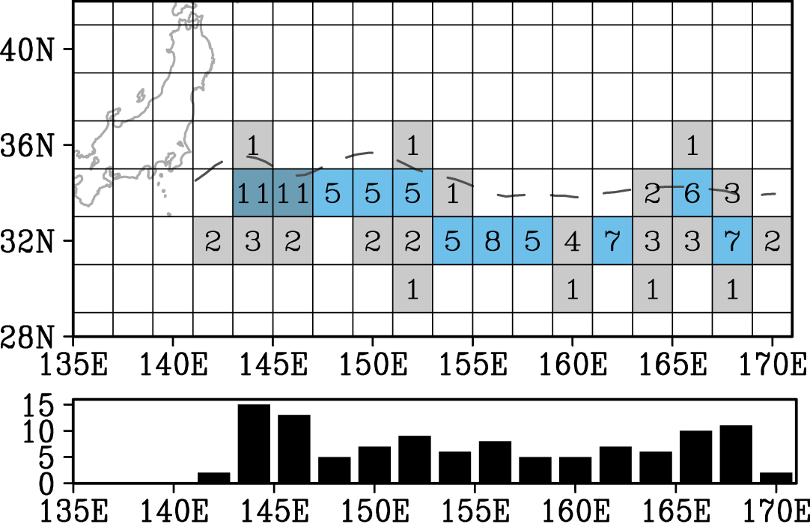
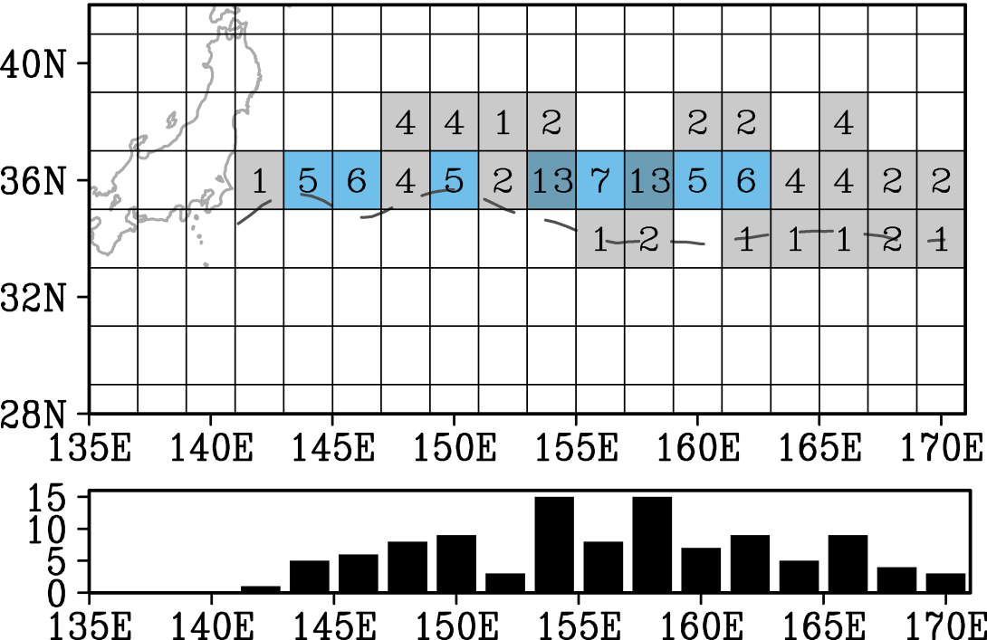
Location of ring formation
Cyclonic
Anticyclonic
107 anticyclonic and 111 cyclonic rings are formed in the KE region from 1992 to 2010
Cyclonic (Anticyclonic) rings are frequently shed in the upstream (downstream) region

Slide 12
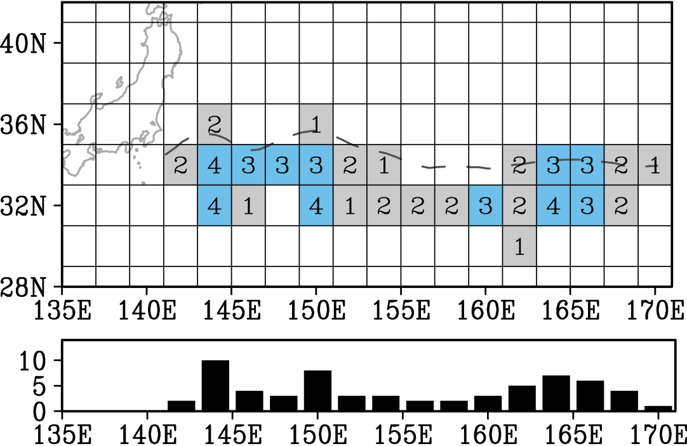
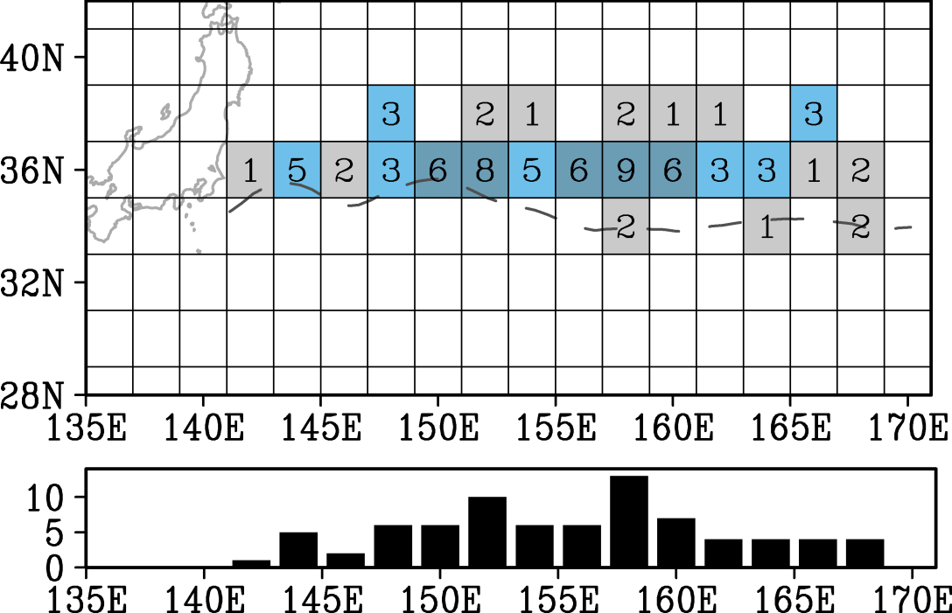
Location of ring absorption
Cyclonic
Anticyclonic
About two-third of the rings (141 rings) returned to the jet
⇒Next, we estimate across-jet heat transport by rings that are not returned to the jet

Slide 13
Across-jet heat transport
A heat content anomaly H associated with a ring is
H = (Sea level anomaly) × ρc_{p} A/α,
where ρ is density, c_{p} is specific heat, A is area of rings and α is thermal expansion coefficient
The frequency of ring formation was 4.3 per year
Using these values, the across-jet heat transport by the rings is 2.3 × 10¹³ W (= 0.023 PW)
This is about one-fourth of the meridional eddy heat transport across the North Pacific at 35°N (~1.0 x 10¹⁴ W)

Slide 14
Summary
The new method for detecting pinch-off rings is proposed
107 anticyclonic and 111 cyclonic ring formations are observed from 1992 to 2010, while about two-third of these rings returned to the jet
One-fourth of the meridional eddy heat transport was caused by the rings shed from the KE jet
Sasaki, Y. N., and S. Minobe, 2015: Climatological mean features and interannual to decadal variability of ring formations in the Kuroshio Extension region. Journal of Oceanography, 71, 499-509, doi:10.1007/s10872-014-0270-4.

